Slide 1
Customer Churn Prediction
Bhavana Gubbi

Slide 2
About Dataset
Train Dataset has 6650 records with 10 features & target class.
Test Dataset has 2851 records with 10 features.
Categorical Features:
Income
Gender
Credit Category &
Product holdings

Slide 3
FEATURE ENGINEERING- PART 1
Combining both the datasets (train & test) as one DF.
Dropping the column ‘ID’ from the combined DF i.e. data.
CATEGORICAL FEATURE TRAINING:
________________________________________________
Label Encoding the below Features:
Gender: Female as 0 & Male as 1.
Income: 'Less than 5L':0,'5L - 10L':1,'10L - 15L':2,'More than 15L’:3
Product Holdings: '1':1,'2':2,'3+’:3
Credit Category: 'Poor':0,'Average':1,'Good':2

Slide 4
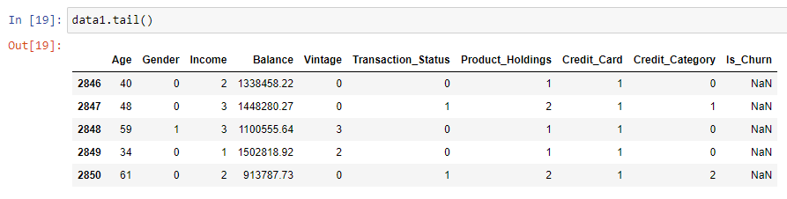
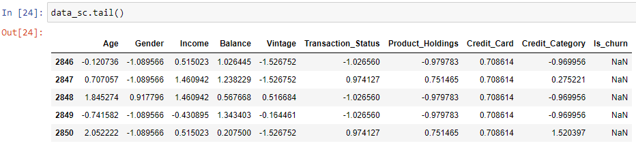
FEATURE ENGINEERING- PART2
As the features values are all on a different scale.
Need to do standard scaling to bring them all on same scale.

Slide 5
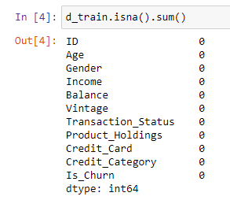
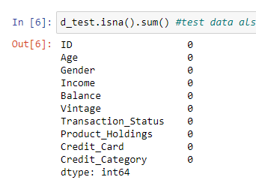
EDA
No Null Values found in both the Train & Test Datasets.

Slide 6
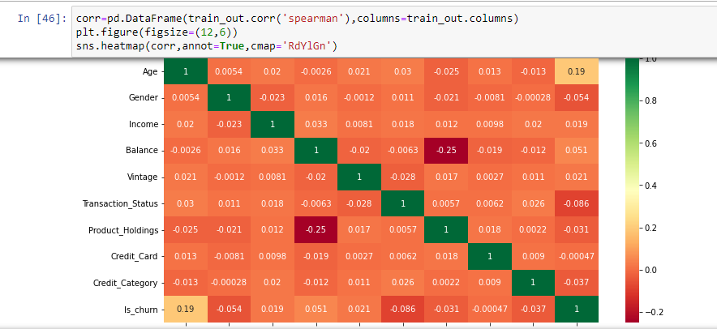
Heat Map
All the independent features are independent of each other.
Each feature is contributing for the target.

Slide 7
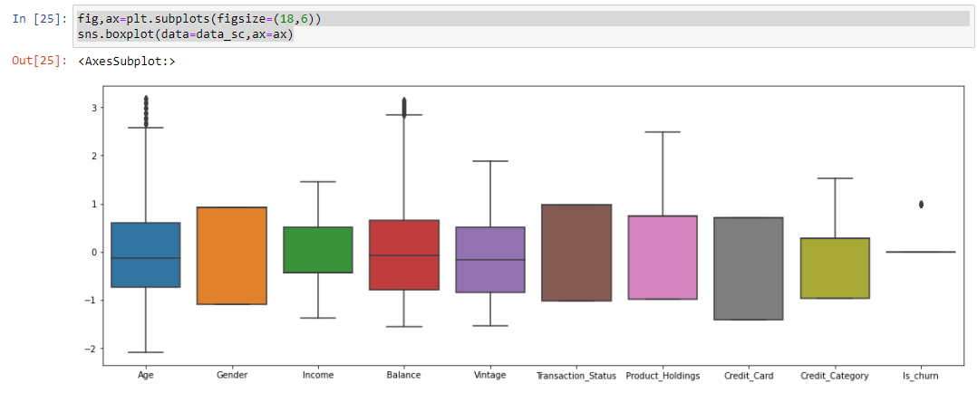
Finding Outliers

Slide 8
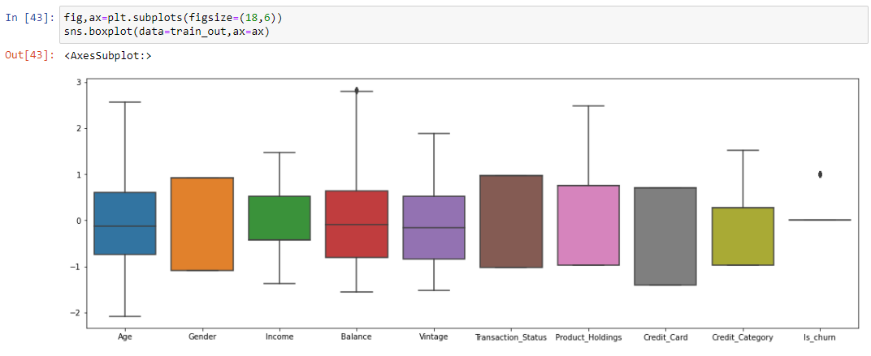
Removing Outliers
Removing Outliers 95 records from Train Dataset alone.
After Removing Outliers:

Slide 9
Model Training- Vanilla:
Using Logistic, SVC, DEC, KNN, RF & Naive without hyper parameter training.
Model | Train | CV | Test
Logistic | 77% | 79% | 48%
SVC | 77% | 78% | 43.4%
DEC | 100% | 67% | 51%
KNN | 79% | 75% | 54%
RF | 100% | 76% | 50%
Naïve Bayes | 77% | 78% | 49%

Slide 10
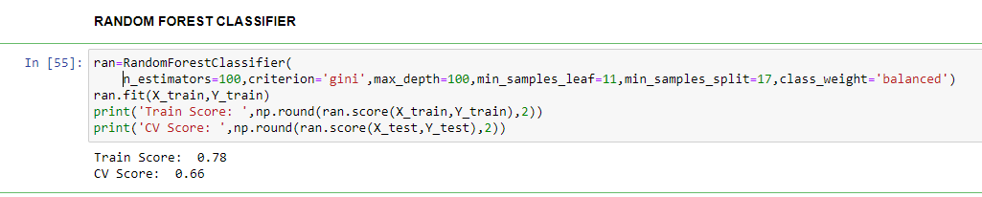
RF (RANDOM FOREST) with BAGGING:
After hyper Parameter tuning, RF gave a test accuracy of : 58.97%
With Bagging, with 20 base estimators, RF gave test accuracy of: 60.06%

